Slide 1
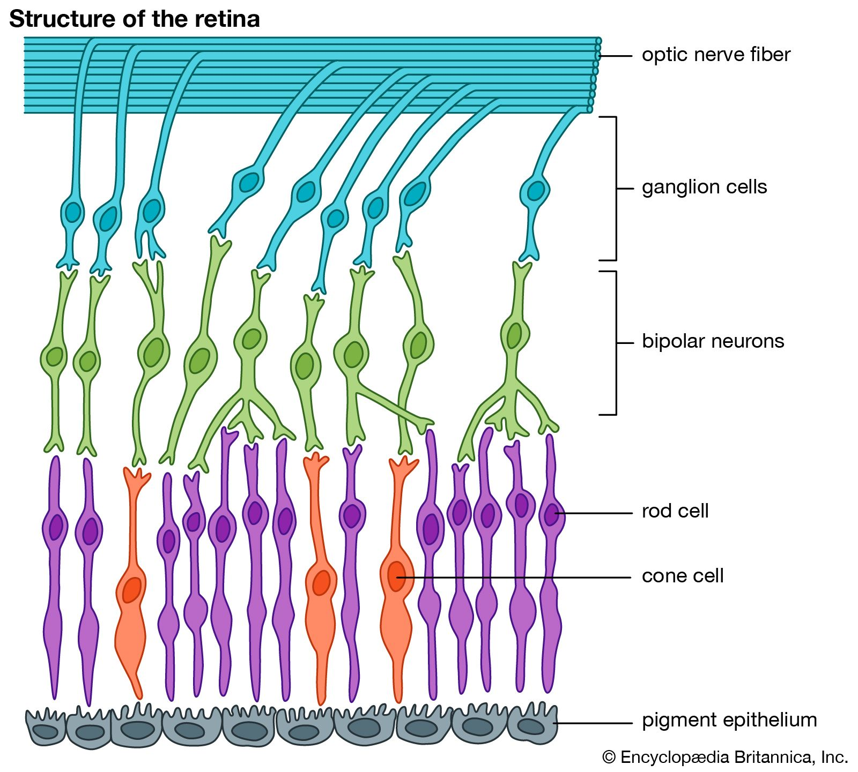

Slide 2
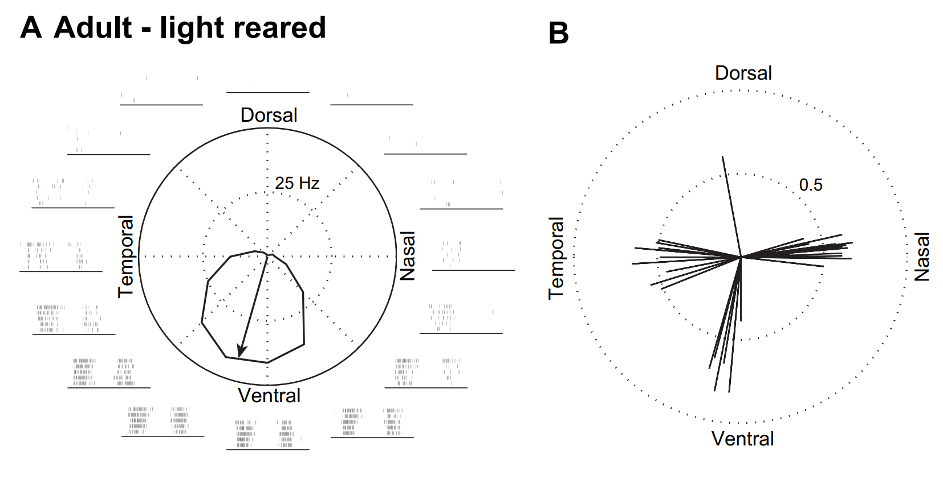
Direction-selective ganglion cells

Slide 3
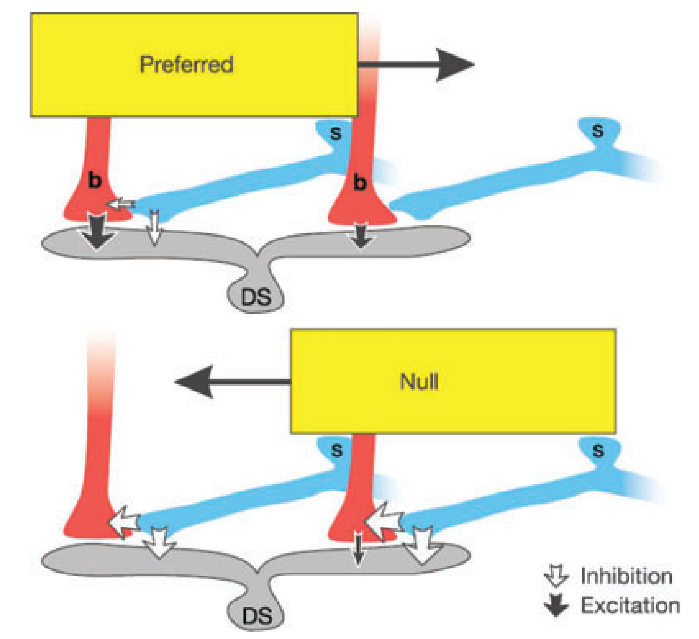
Direction selectivity is due to asymmetric inhibition from amacrine cells

Slide 4
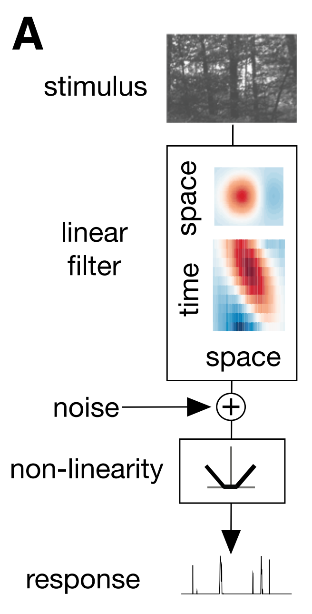
Model of DSGC: Space-time inseparable filter

Slide 5
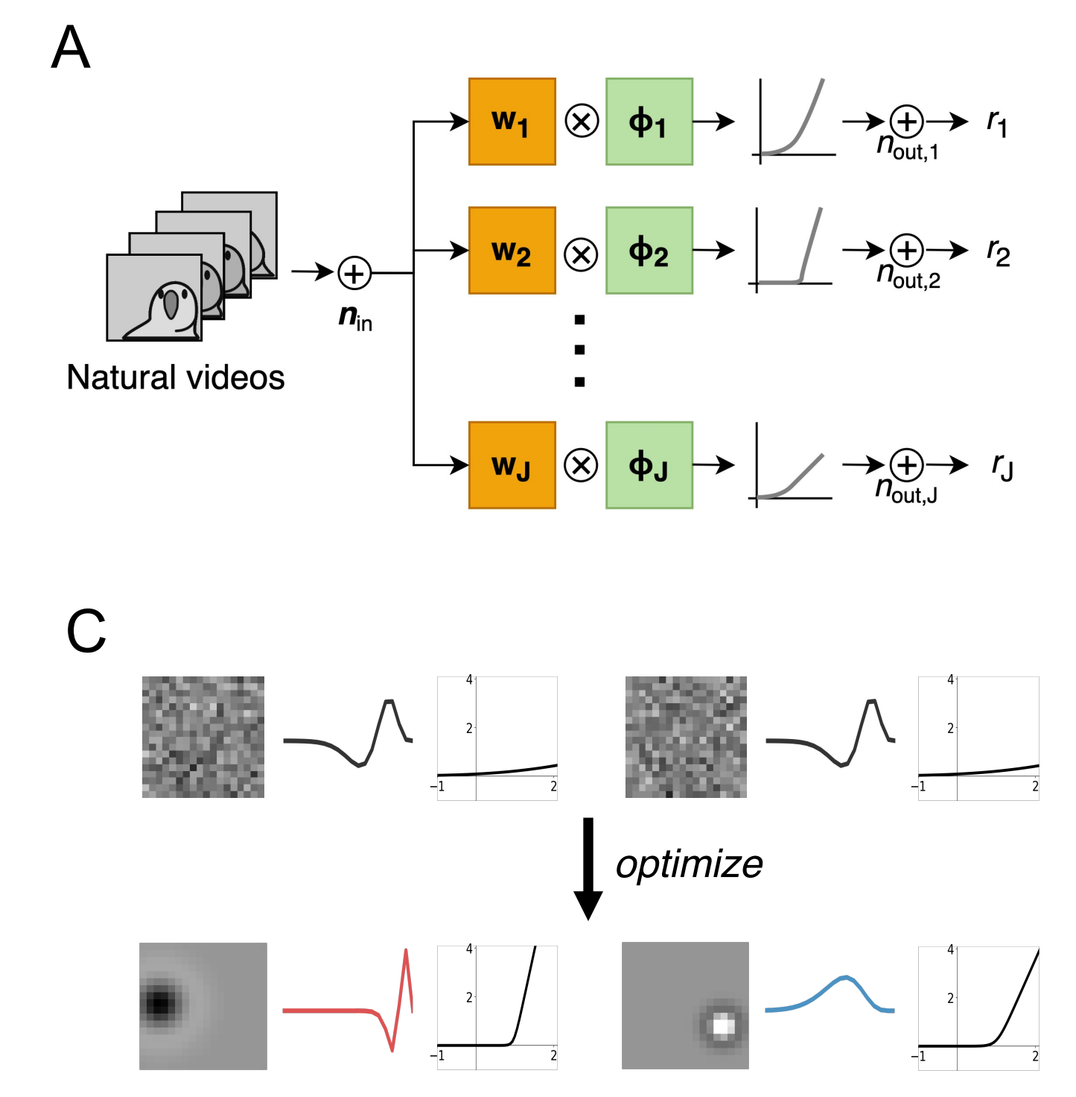
Previous work from the Pearson lab: Space-time separable filters

Slide 6
New potential model

